Slide 1
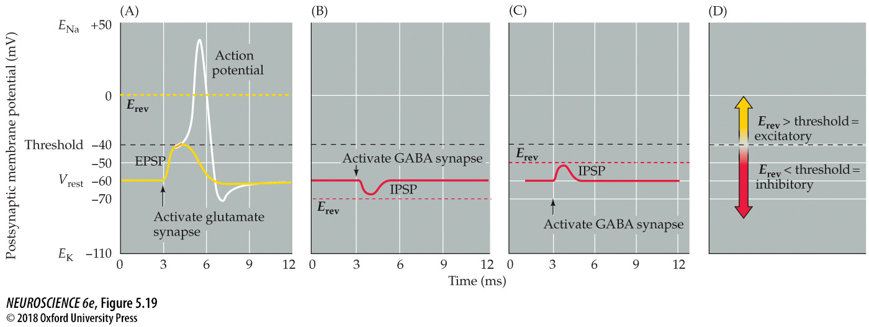
Reversal potentials and threshold potentials determine postsynaptic excitation and inhibition
Notes:
FIGURE 5.19 Reversal potentials and threshold potentials determine postsynaptic excitation and inhibition. (A) If the reversal potential for a PSP (0 mV) is more positive than the action potential threshold (–40 mV), the effect of a transmitter is excitatory, and it generates EPSPs. (B) If the reversal potential for a PSP is more negative than the action potential threshold, the transmitter is inhibitory and generates IPSPs. (C) IPSPs can nonetheless depolarize the postsynaptic cell if their reversal potential is between the resting potential and the action potential threshold. (D) The general rule of postsynaptic action is: If the reversal potential is more positive than threshold, excitation results; inhibition occurs if the reversal potential is more negative than threshold.

Slide 2
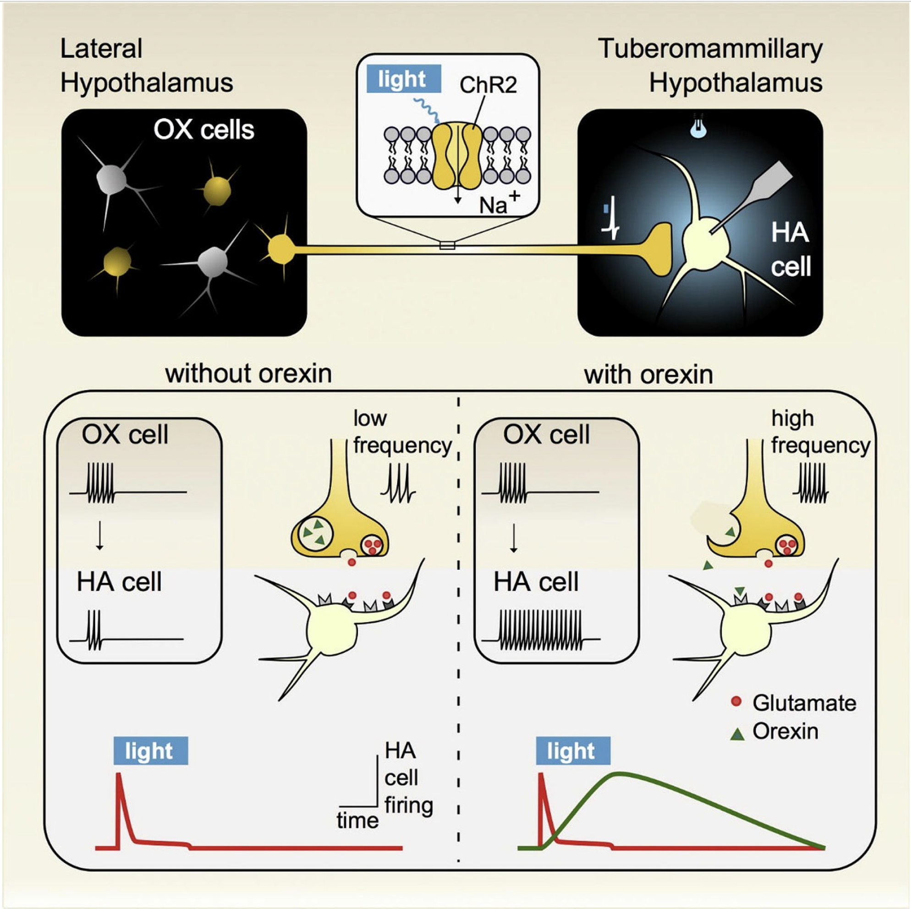
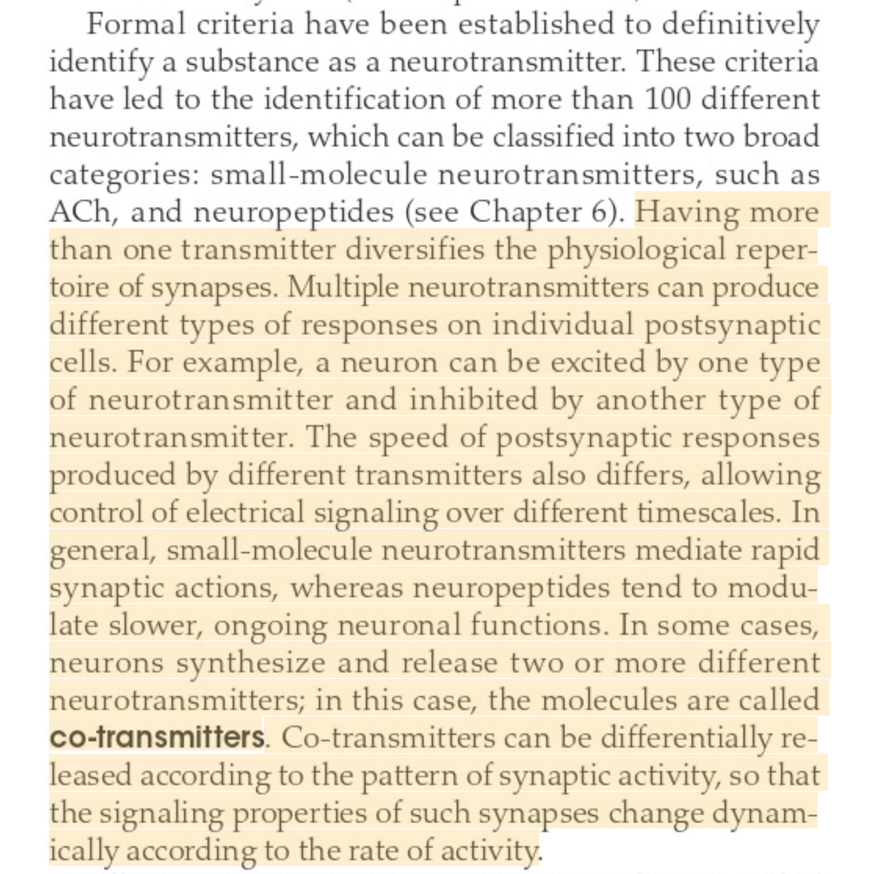
How many neurotransmitters does one neuron receive, and how many can it release?
Chap 5, p.89:
From: General Principles of Neuronal Co-transmission: Insights From Multiple Model Systems
By Erik Svensson et al. 2019

Slide 3
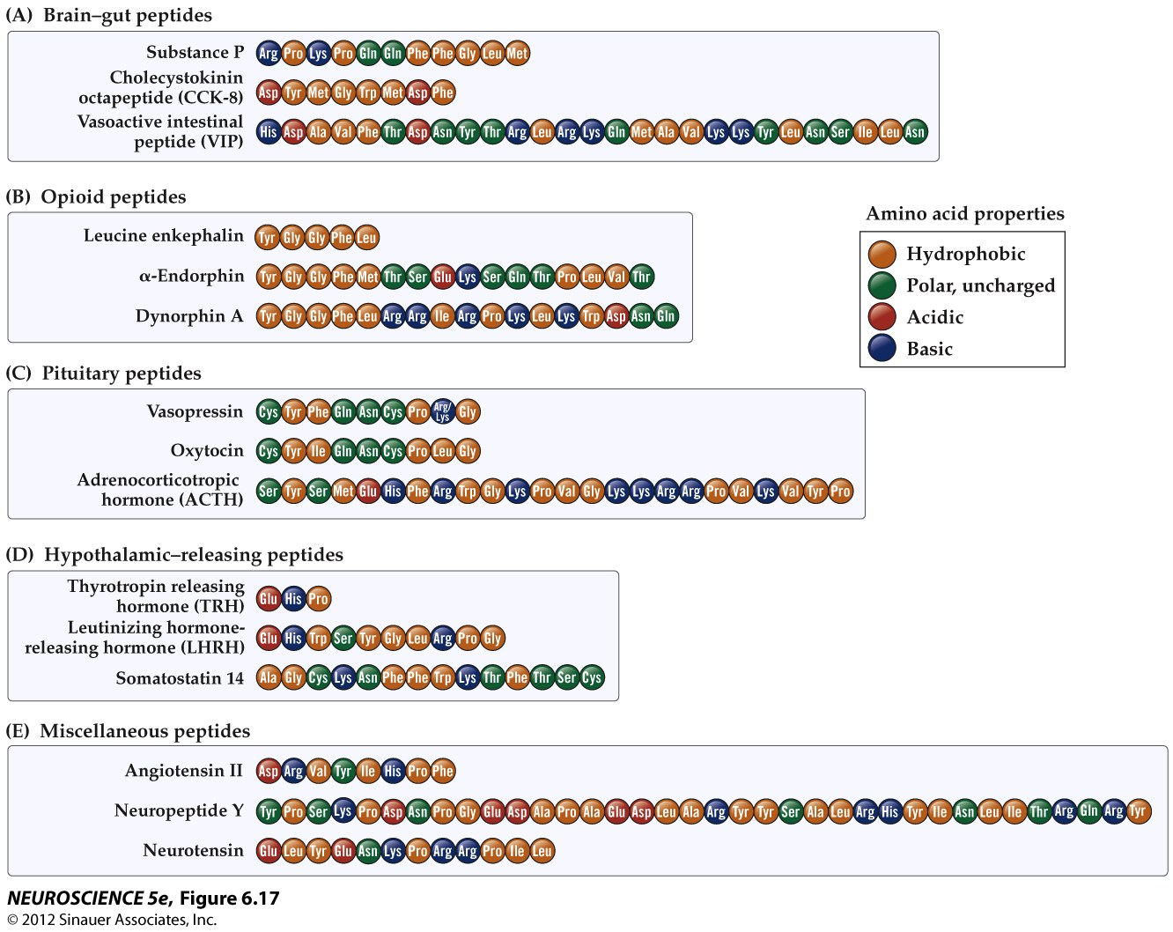
Amino acid sequences of neuropeptides

Slide 4
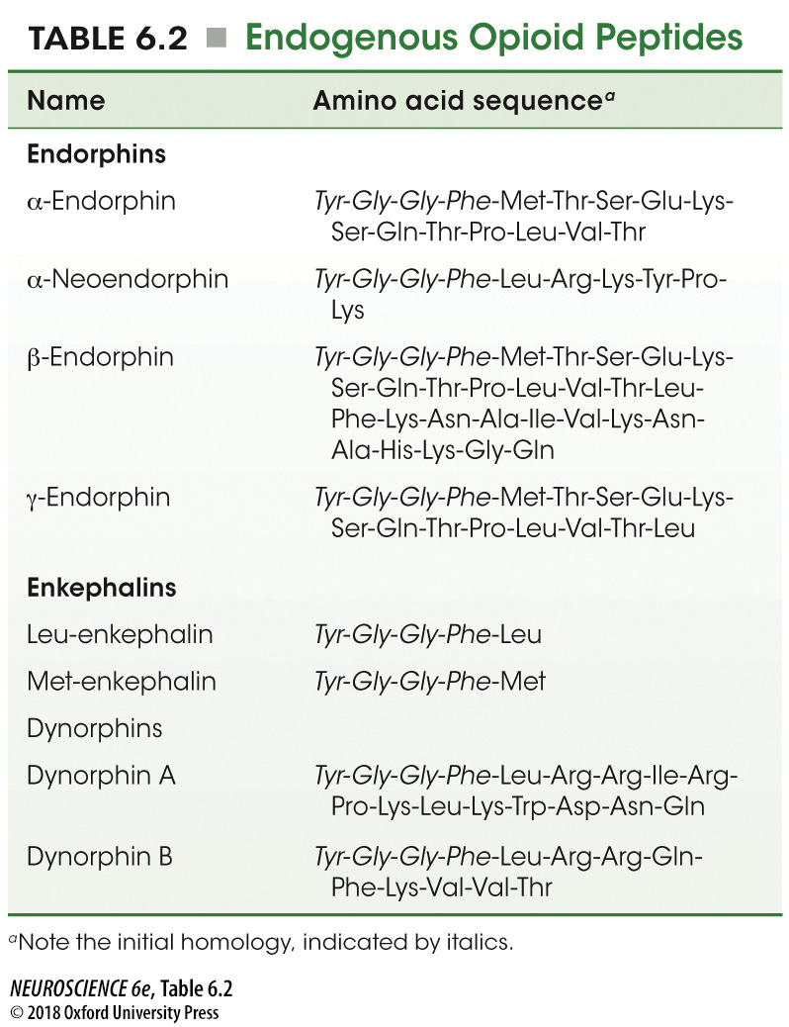
Endogenous Opioid Peptides
Notes:
TABLE 6.2 Endogenous Opioid Peptides

Slide 5
BMD ENG 301Quantitative Systems Physiology (Nervous System)
Lecture 12: Metabotropic Receptors
2022_v1
Professor Malcolm MacIver

Slide 6
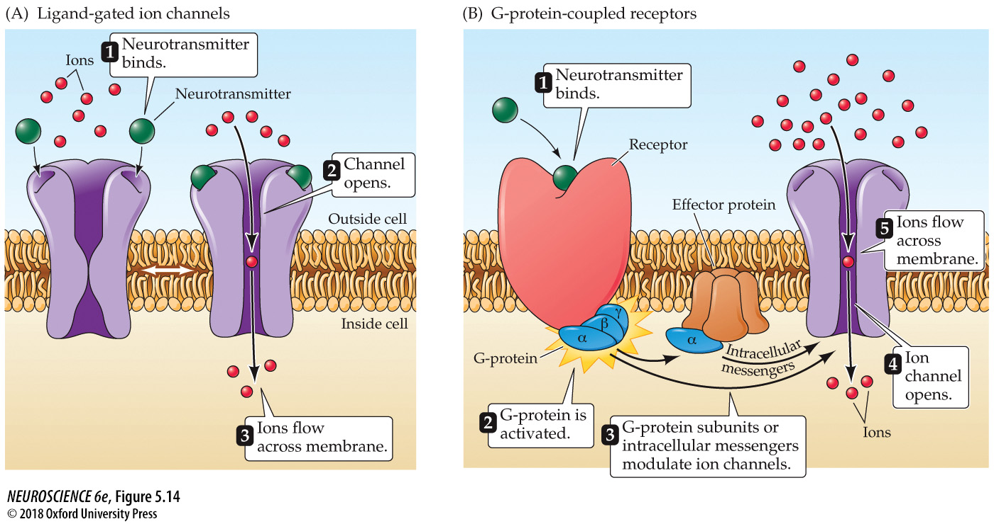
Two different types of neurotransmitter receptors
Fast
Slow
Notes:
FIGURE 5.14 Two different types of neurotransmitter receptors. (A) Ligand-gated ion channels combine receptor and channel functions in a single protein complex. (B) Metabotropic receptors usually activate G-proteins, which modulate ion channels directly or indirectly through intracellular effector enzymes and second messengers.

Slide 7
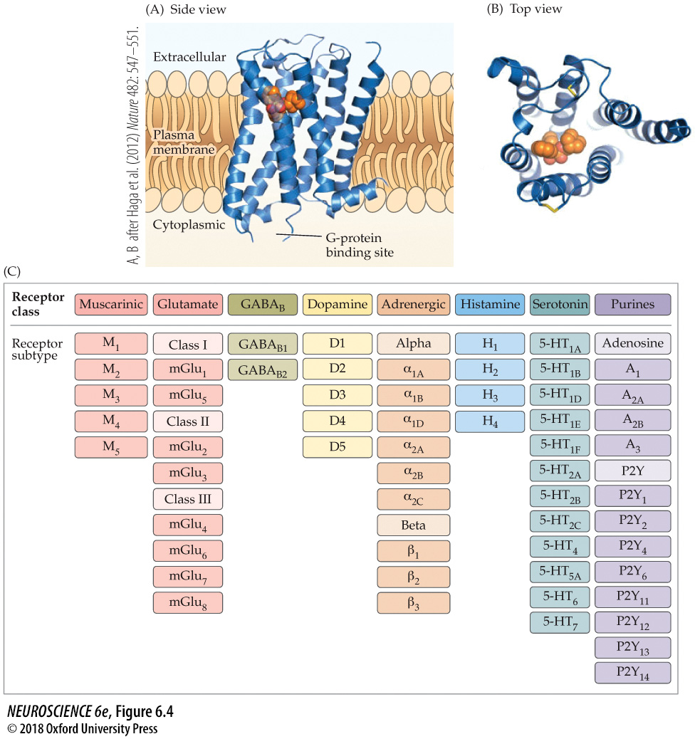
Metabotropic Receptors

Slide 8
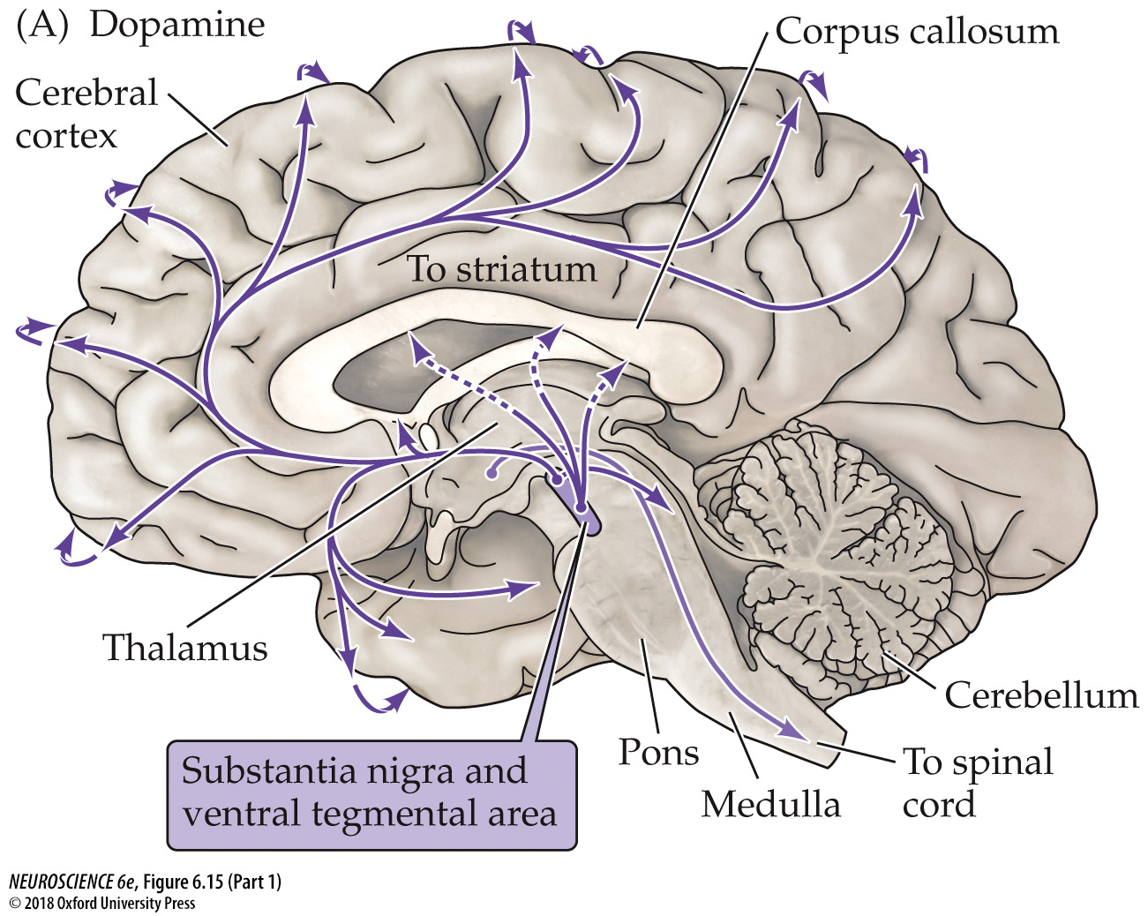
The distribution of dopamine in the human brain
Notes:
FIGURE 6.15 The distribution of catecholamine neurotransmitters in the human brain. Shown are neurons and their projections (arrows) that contain catecholamine neurotransmitters. Curved arrows along the perimeter of the cortex indicate the innervation of lateral cortical regions not shown in this midsagittal plane of section.

Slide 9
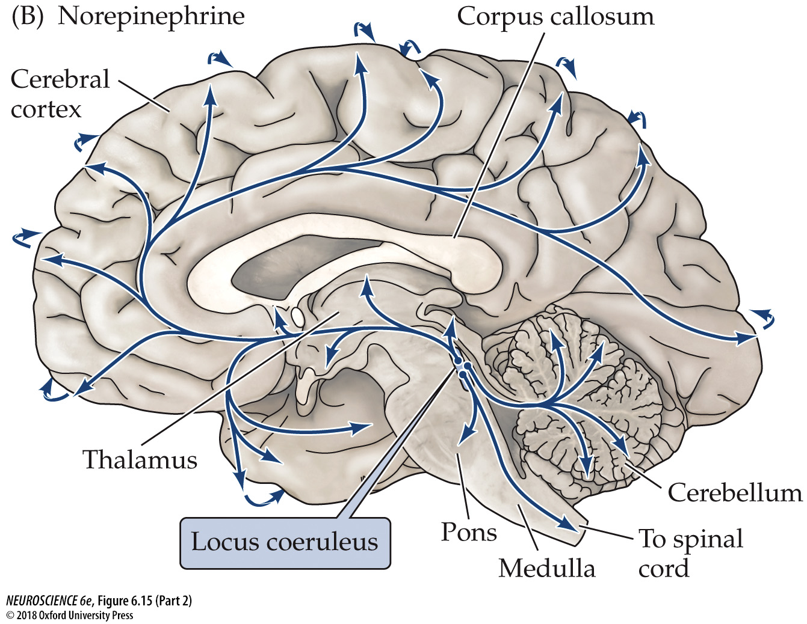
The distribution of noradrenaline in the human brain
Notes:
FIGURE 6.15 The distribution of catecholamine neurotransmitters in the human brain. Shown are neurons and their projections (arrows) that contain catecholamine neurotransmitters. Curved arrows along the perimeter of the cortex indicate the innervation of lateral cortical regions not shown in this midsagittal plane of section.

Slide 10
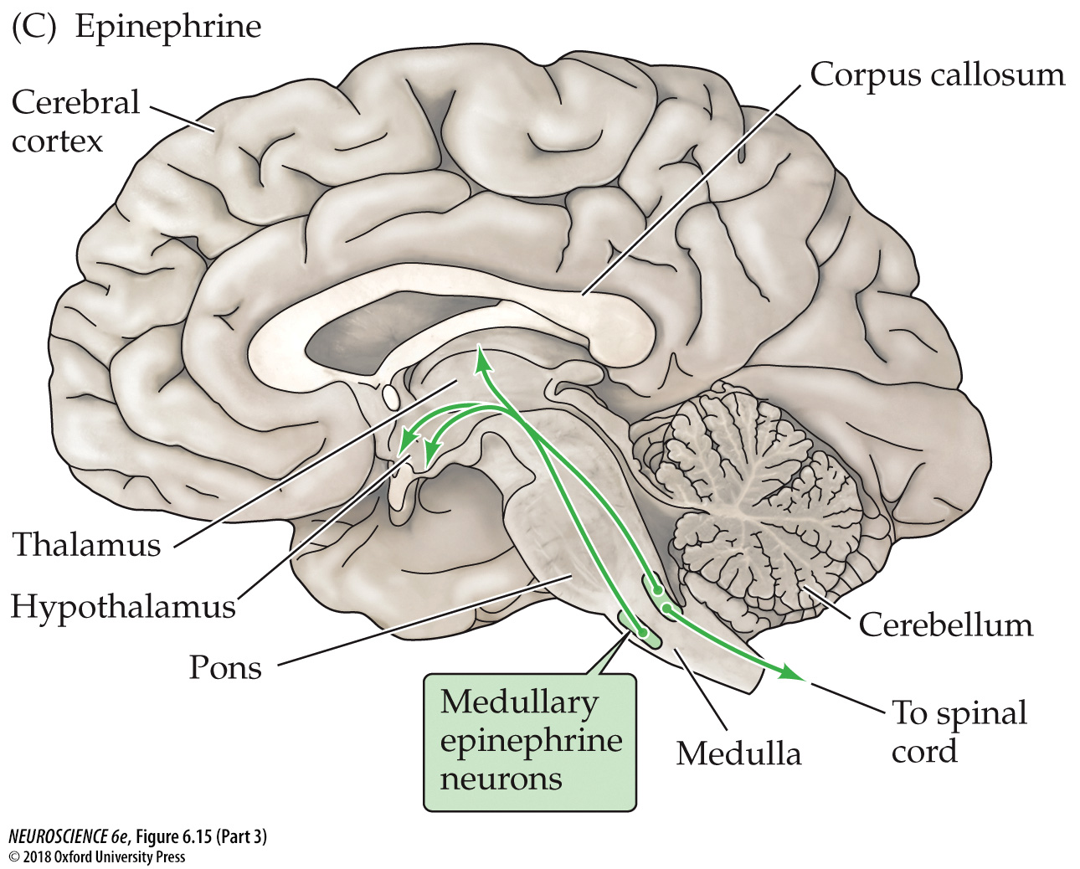
The distribution of adrenaline in the human brain
Notes:
FIGURE 6.15 The distribution of catecholamine neurotransmitters in the human brain. Shown are neurons and their projections (arrows) that contain catecholamine neurotransmitters. Curved arrows along the perimeter of the cortex indicate the innervation of lateral cortical regions not shown in this midsagittal plane of section.

Slide 11
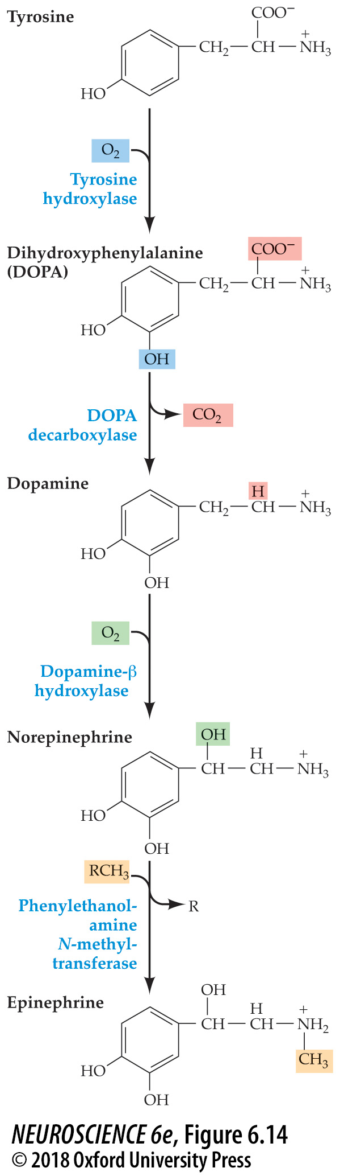
The biosynthetic pathway for the catecholamine neurotransmitters
Notes:
FIGURE 6.14 The biosynthetic pathway for the catecholamine neurotransmitters. The amino acid tyrosine is the precursor for all three catecholamines. The first step in this reaction pathway, catalyzed by tyrosine hydroxylase, is rate-limiting.

Slide 12
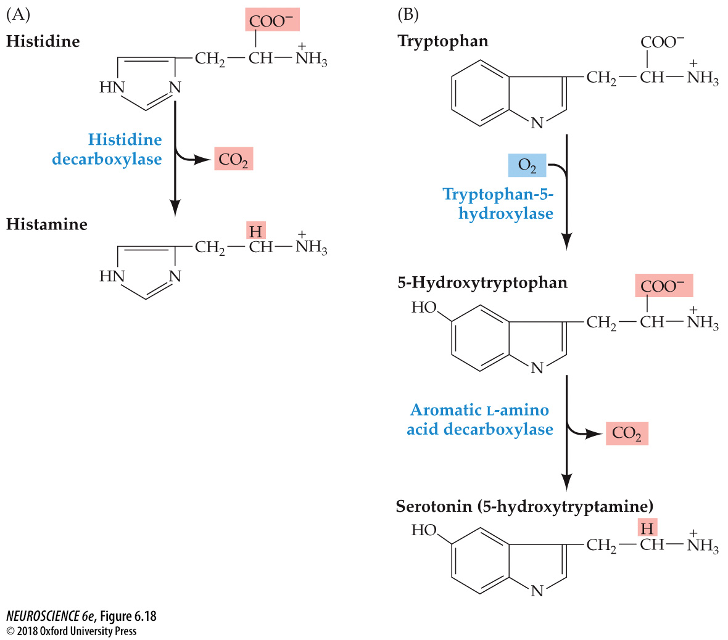
Synthesis of histamine and serotonin
Notes:
FIGURE 6.18 Synthesis of histamine and serotonin. (A) Histamine is synthesized from the amino acid histidine. (B) Serotonin is derived from the amino acid tryptophan by a two-step process that requires the enzymes tryptophan-5-hydroxylase and a decarboxylase.

Slide 13
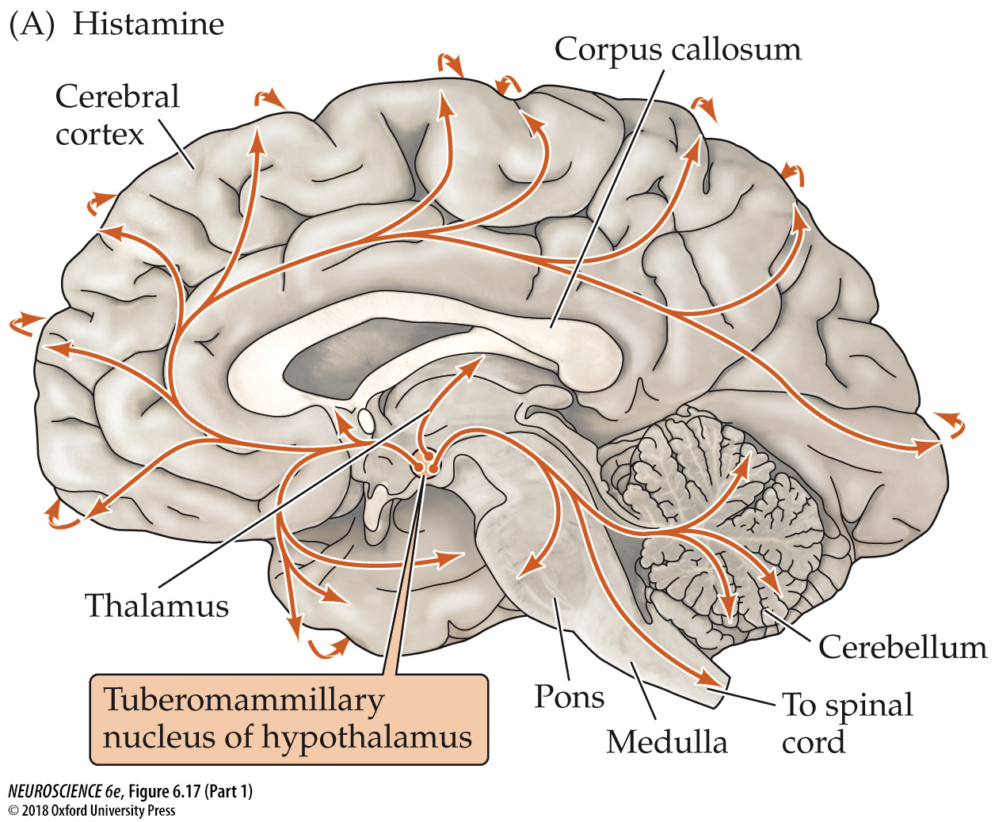
The distribution of histamine neurotransmitter in the human brain
Notes:
FIGURE 6.17 The distribution of histamine and serotonin neurotransmitters in the human brain. Diagrams show the distribution of neurons and their projections (arrows) containing histamine (A) or serotonin (B). Curved arrows along the perimeter of the cortex indicate the innervation of lateral cortical regions not shown in this midsagittal plane of section.

Slide 14
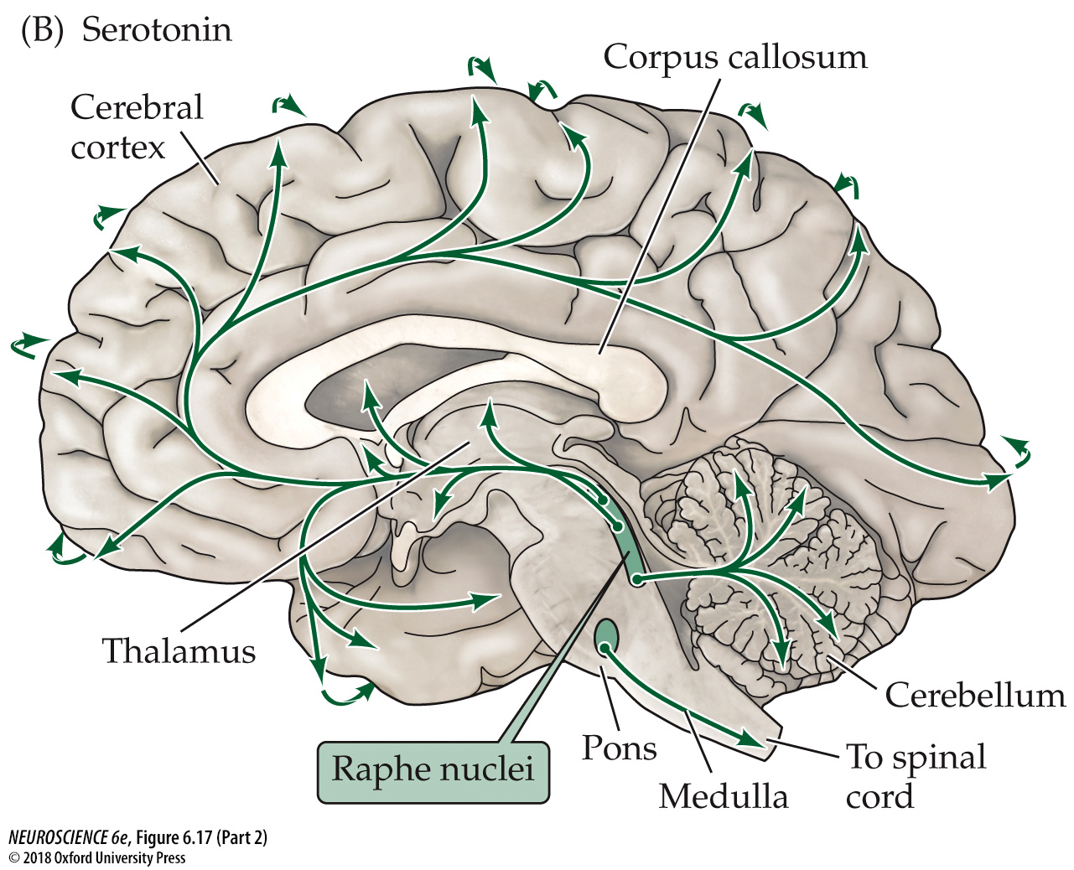
The distribution of serotonin neurotransmitter in the human brain
Notes:
FIGURE 6.17 The distribution of histamine and serotonin neurotransmitters in the human brain. Diagrams show the distribution of neurons and their projections (arrows) containing histamine (A) or serotonin (B). Curved arrows along the perimeter of the cortex indicate the innervation of lateral cortical regions not shown in this midsagittal plane of section.

Slide 15
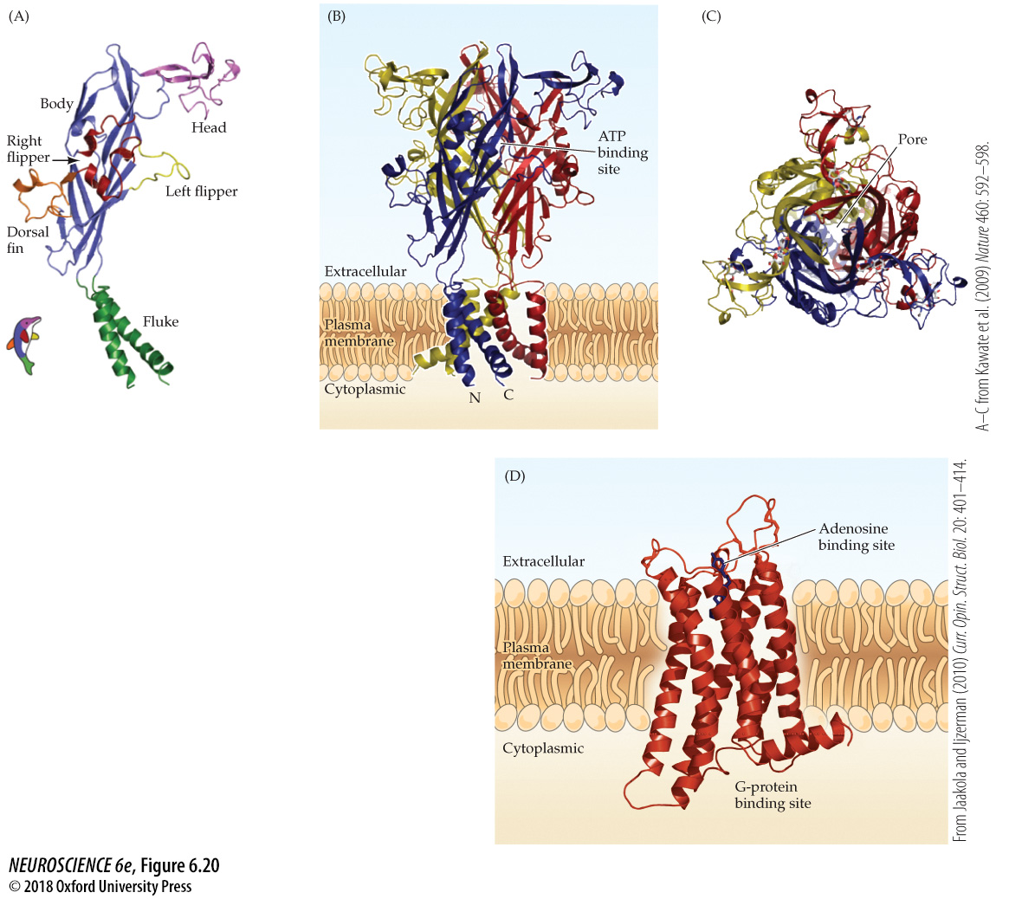
Purinergic receptors
Notes:
FIGURE 6.20 Purinergic receptors. (A) Subunit of anionotropic P2X₄ receptor. Each subunit has a transmembrane domain consisting of two helical structures that form part of a channel, as well as a large extracellular domain that includes the ATP binding site. The shape of the subunit is reminiscent of a dolphin, with the structures color-coded as indicated in the inset. (B) Side view of a P2X₄ receptor; this receptor is a trimer of three subunits, with each subunit shown in a different color. The ATP binding site is proposed to be in the center of the extracellular domain. (C) Top view of the P2X₄ receptor, indicating the centrally located channel pore. (D) Structure of a metabotropic A_{2A} adenosine receptor. This receptor has the seven-membrane-spanning domain structure characteristic of metabotropic receptors and is shown with an antagonist drug (purple structure) occupying the adenosine binding site. (A–C from Kawate et al., 2009; D from Jaakola and Ijzerman, 2010.)

Slide 16
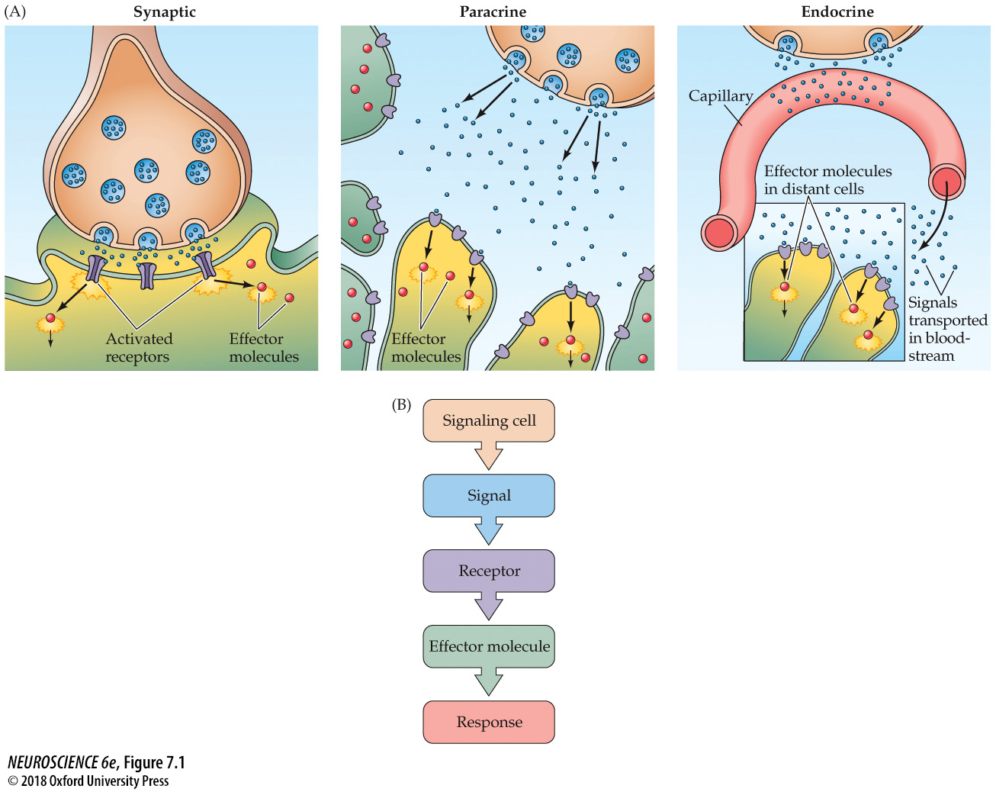
Chemical signaling
Pre-synaptic
Neurotransmitter
Ionotropic or Metabotropic
Ions or 2nd Messenger Pathway
Simple or Complex
Notes:
FIGURE 7.1 Chemical signaling. (A) Forms of chemical communication include synaptic transmission, paracrine signaling, and endocrine signaling. (B) The essential components of chemical signaling are: cells that initiate the process by releasing signaling molecules; specific receptors on target cells; intracellular effector molecules; and subsequent cellular responses.

Slide 17
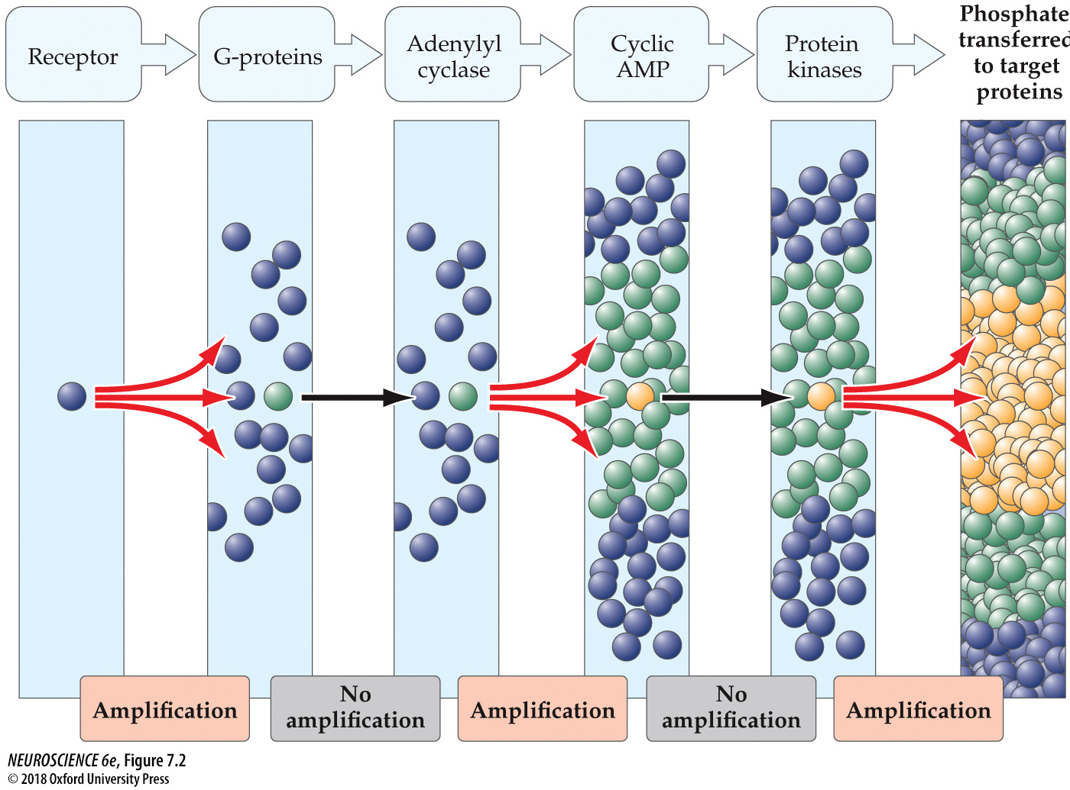
Amplification in signal transduction pathways
Notes:
FIGURE 7.2 Amplification in signal transduction pathways. The activation of a single receptor by a signaling molecule, such as the neurotransmitter norepinephrine, can lead to the activation of numerous G-proteins inside cells. These activated proteins can bind to other signaling molecules, such as the enzyme adenylyl cyclase. Each activated enzyme molecule generates a large number of cAMP molecules. cAMP binds to and activates another family of enzymes—the protein kinases—that can phosphorylate many target proteins. Although not every step in this signaling pathway involves amplification, overall the cascade results in a tremendous increase in the potency of the initial signal.

Slide 18
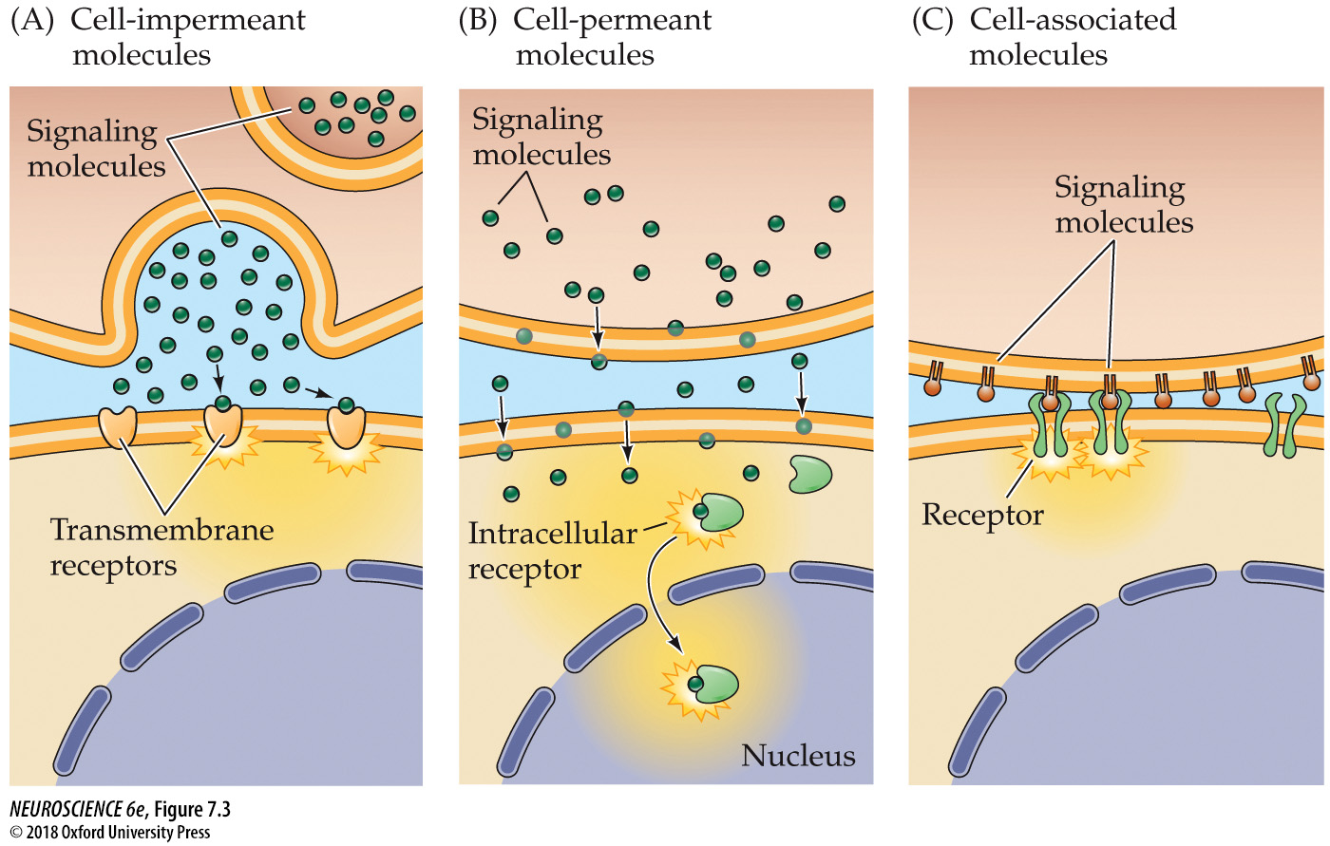
Three classes of cell signaling molecules
Notes:
FIGURE 7.3 Three classes of cell signaling molecules. (A) Cell-impermeant molecules, such as neurotransmitters, cannot readily traverse the plasma membrane of the target cell and must bind to the extracellular portion of transmembrane receptor proteins. (B) Cell-permeant molecules are able to cross the plasma membrane and bind to receptors in the cytoplasm or nucleus of target cells.(C) Cell-associated molecules are presented on the extracellular surface of the plasma membrane. These signals activate receptors on target cells only if they are directly adjacent to the signaling cell.

Slide 19
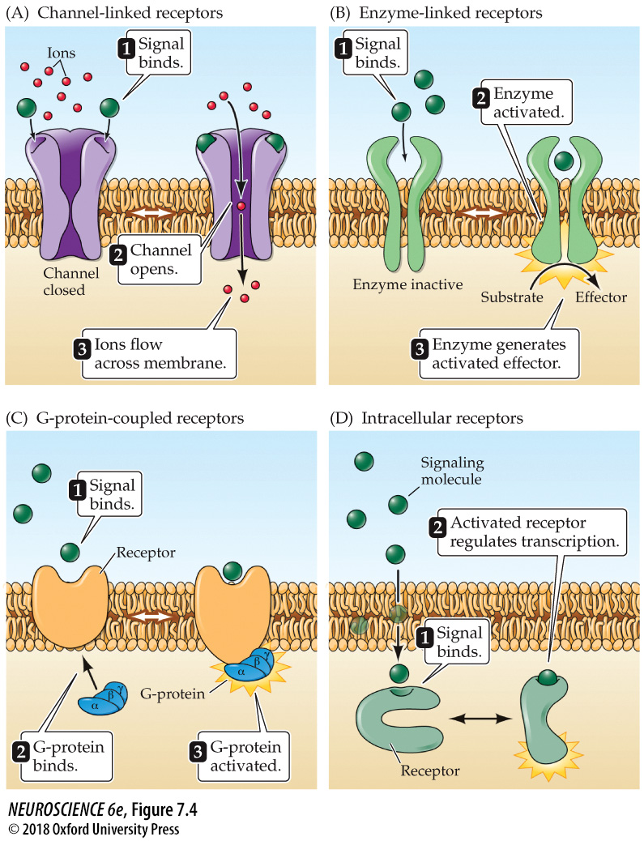
Categories of cellular receptors
Notes:
FIGURE 7.4 Categories of cellular receptors. Cell-impermeant signaling molecules can bind to and activate channel-linked receptors (A), enzyme-linked receptors (B), or G-protein-coupled receptors (C). Cell-permeant signaling molecules activate intracellular receptors (D).

Slide 20
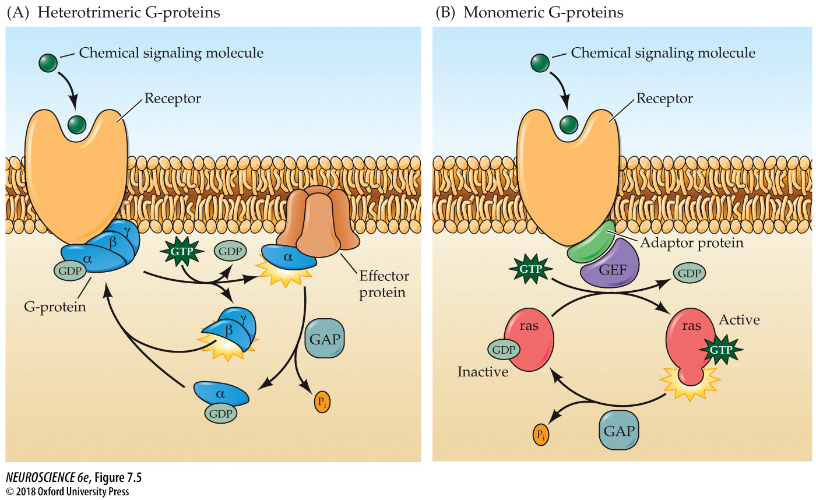
Types of GTP-binding proteins
Notes:
FIGURE 7.5 Types of GTP-binding proteins. (A) Heterotrimeric G-proteins consist of three distinct subunits (α, β, and γ). Receptor activation causes the binding of the G-protein and the α subunit to exchange GDP for GTP, leading to a dissociation of the α and βv subunits. The biological actions of these G-proteins are terminated by hydrolysis of GTP, which is enhanced by GTPase-activating (GAP) proteins. (B) Monomeric G-proteins use similar mechanisms to relay signals from activated cell surface receptors to intracellular targets. The biological actions of these G-proteins depends on binding of GTP, which is activated by guanine nucleotide exchange factors (GEFs) that bind to the receptor in association with adaptor proteins, and their activity is terminated by hydrolysis of GTP, which is also regulated by GAP proteins.

Slide 21
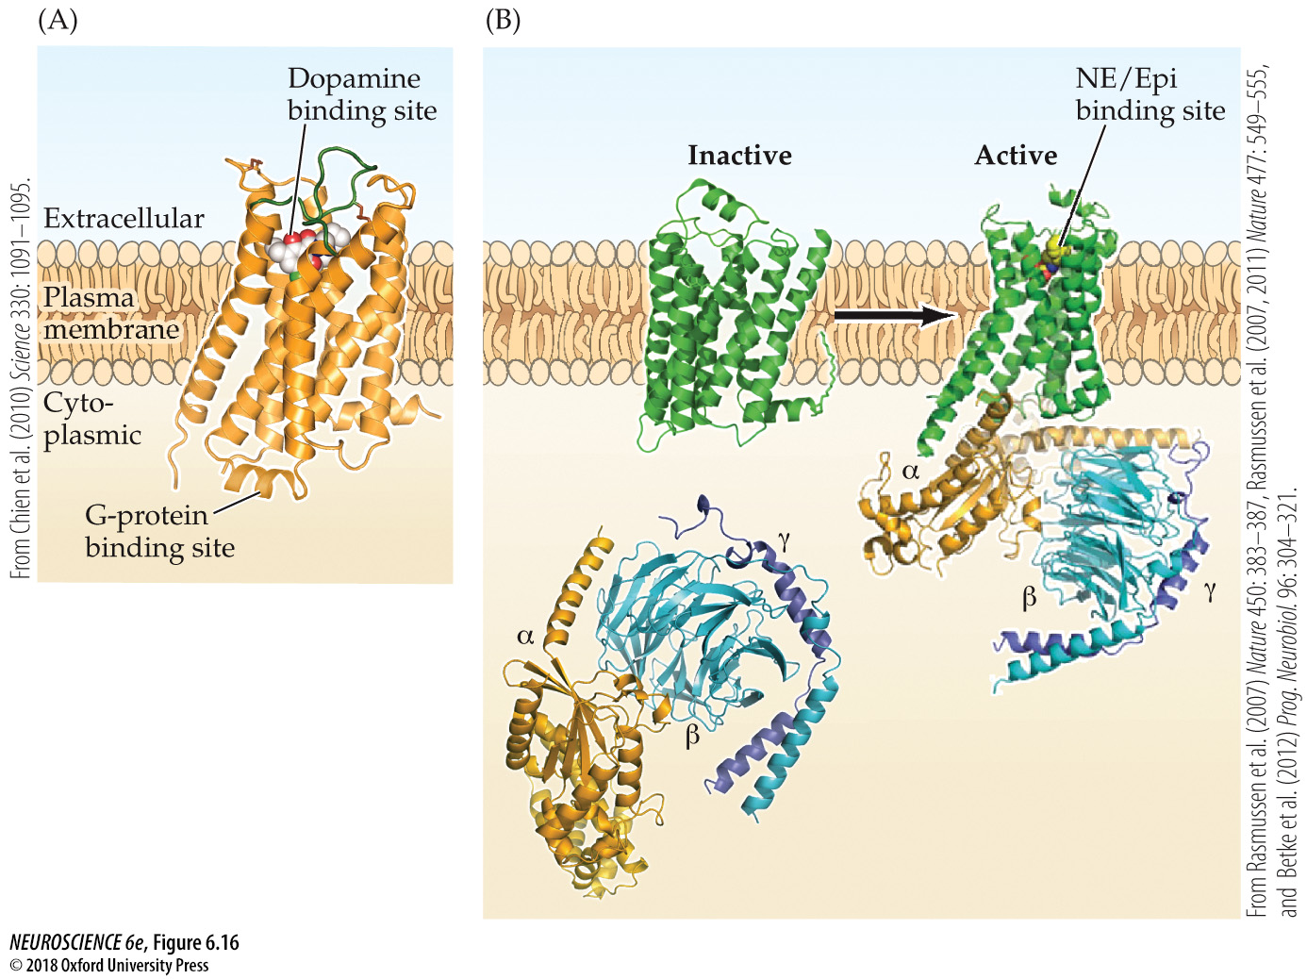
Metabotropic receptors for catecholamine neurotransmitters
Notes:
FIGURE 6.16 Metabotropic receptors for catecholamine neurotransmitters. (A) Structure of the D3 dopamine receptor. Like all metabotropic receptors, the D3 receptor spans the plasma membrane seven times and has a cytoplasmic domain that binds to and activates G-proteins, as well as an extracellular domain that binds dopamine. (B) Structure of the β₂-adrenergic receptor and its associated G-protein. (Left) In the absence of ligand, the cytoplasmic domain of the β₂ receptor is not bound to the G-protein (α,β, and γ subunits). (Right) Binding of ligand (β agonist, indicated by colored spheres) to the extracellular binding site for norepinephrine (NE) and epinephrine (Epi) causes the β₂ receptor to bind to the α subunit of the G-protein, which in turn induces a dramatic change in the structure of this subunit. (A from Chien et al., 2010; B from Rasmussen et al., 2007, 2011 and Betke et al., 2012.)

Slide 22
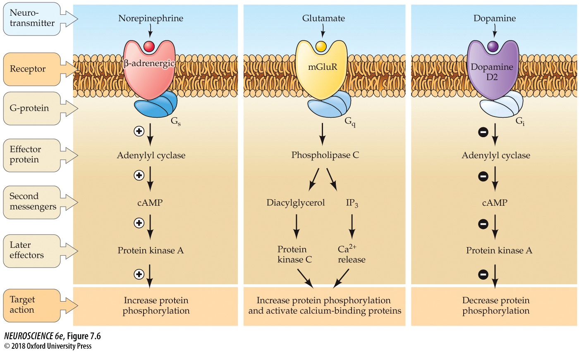
Effector pathways associated with G-protein-coupled receptors
Effector protein is usually associated with the plasma membrane
Notes:
FIGURE 7.6 Effector pathways associated with G-protein-coupled receptors. In all three examples shown here, binding of a neurotransmitter to such a receptor leads to activation of a G-protein and subsequent recruitment of second-messenger pathways. G_{s}, G_{q}, and G_{i} refer to three different types of heterotrimeric G-proteins.

Slide 23
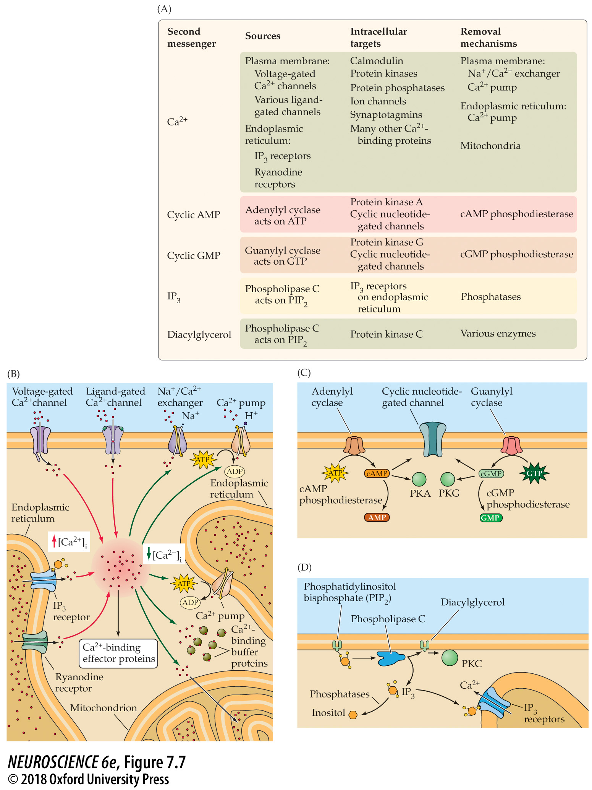
Neuronal second messengers
Phospholipase C
Two immediate, one later
Notes:
FIGURE 7.7 Neuronal second messengers. (A) Mechanisms responsible for producing and removing second messengers, and the downstream targets of these messengers. (B) Proteins involved in delivering calcium to the cytoplasm and in removing calcium from the cytoplasm. (C) Mechanisms for producing and degrading cyclic nucleotides. (D) Pathways involved in producing and removing diacylglycerol and IP₃.

Slide 24
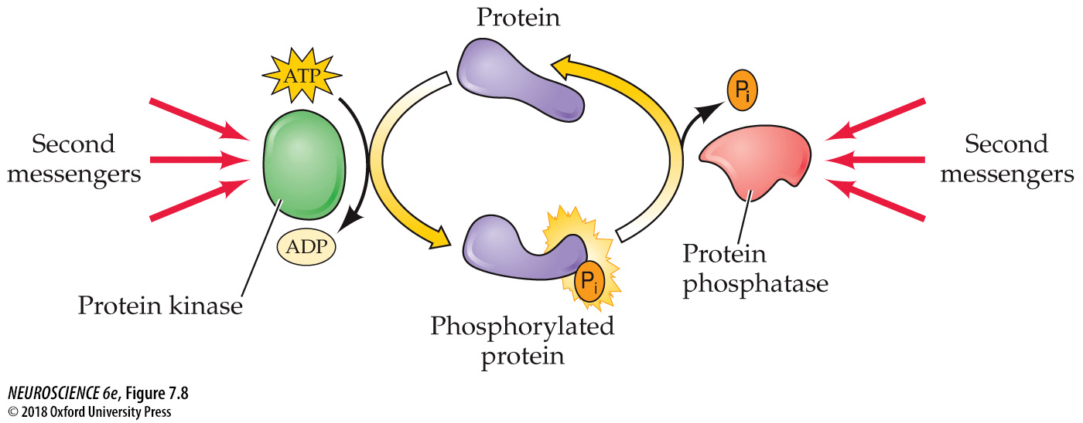
Regulation of cellular proteins by phosphorylation
Notes:
FIGURE 7.8 Regulation of cellular proteins by phosphorylation. Protein kinases transfer phosphate groups (P_{i}) from ATP to serine, threonine, or tyrosine residues on substrate proteins. This phosphorylation reversibly alters the structure and function of cellular proteins. Removal of the phosphate groups is catalyzed by protein phosphatases. Both kinases and phosphatases are regulated by a variety of intracellular second messengers.

Slide 25
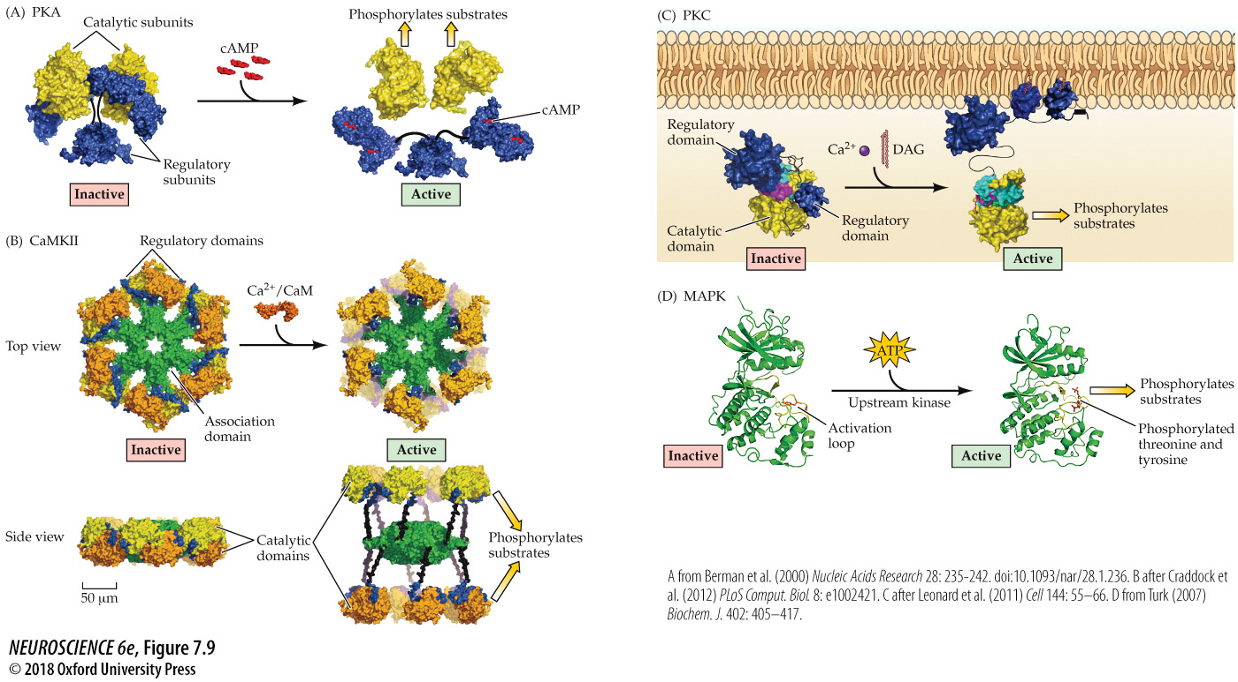
Activation of protein kinases
Notes:
FIGURE 7.9 Activation of protein kinases. (A) In the inactive state (left), the catalytic subunits of PKA are inhibited by the regulatory subunits. Binding of cAMP to the regulatory subunits relieves the inhibition and frees the catalytic subunits to phosphorylate their targets. Black lines indicate flexible structures that connect parts of the regulatory subunit. (B) CaMKII is a large wheel-shaped structure comprising 12 subunits, each with a catalytic (tan/yellow) and a regulatory (blue) domain, held together by a central association domain (green). Binding of Ca²⁺/calmodulin to the regulatory domain allows the catalytic domain to extend and phosphorylate its substrates. (C) Binding of Ca²⁺ allows lipid-binding domains of PKC (blue) to insert into the plasma membrane and bind to DAG and other membrane lipids. This change in structure and location displaces the regulatory domain (blue) allows the catalytic domain of PKC (yellow) to phosphorylate its substrates. Black lines indicate flexible structures that connect the various domains of PKC. (D) Activation of MAPK is caused by phosphorylation of an activation loop (yellow) by upstream kinases. Phosphorylation of the activation loop allows the catalytic domain of MAPK to assume its active conformation and phosphorylate downstream targets. (A from pdb101.rcsb.org; B after Craddock et al., 2012; C after Leonard et al., 2011; D from Turk, 2007.)

Slide 26
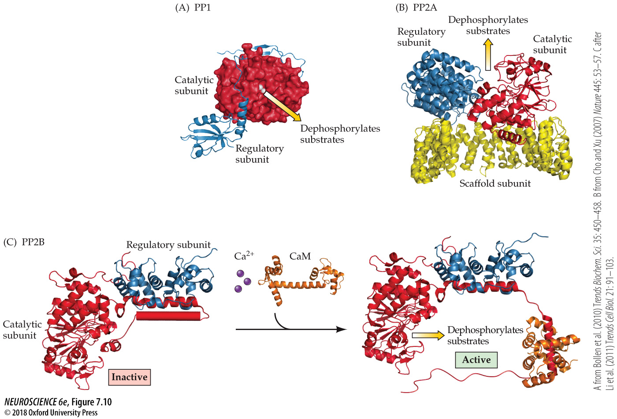
Types of protein phosphatases
Notes:
FIGURE 7.10 Types of protein phosphatases. (A) Structure of PP1, consisting of a catalytic subunit (red) bound to spinophilin (blue), a regulatory subunit found in dendritic spines. (B) PP2A is a trimeric enzyme that has a scaffold subunit (yellow), in addition to the catalytic (red) and regulatory (blue) subunits common to other phosphatases. (C) The activity of PP2B, or calcineurin, is regulated by Ca²⁺/calmodulin. In the absence of Ca²⁺/calmodulin (left), part of the regulatory subunit blocks the active site of the catalytic subunit, preventing phosphatase activity. Binding of Ca²⁺/calmodulin to the regulatory subunit relieves this blockade, allowing PP2B to dephosphorylate its substrate proteins. (A from Bollen et al., 2010; B from Cho and Xu, 2007; C after Li et al., 2011.)

Slide 27
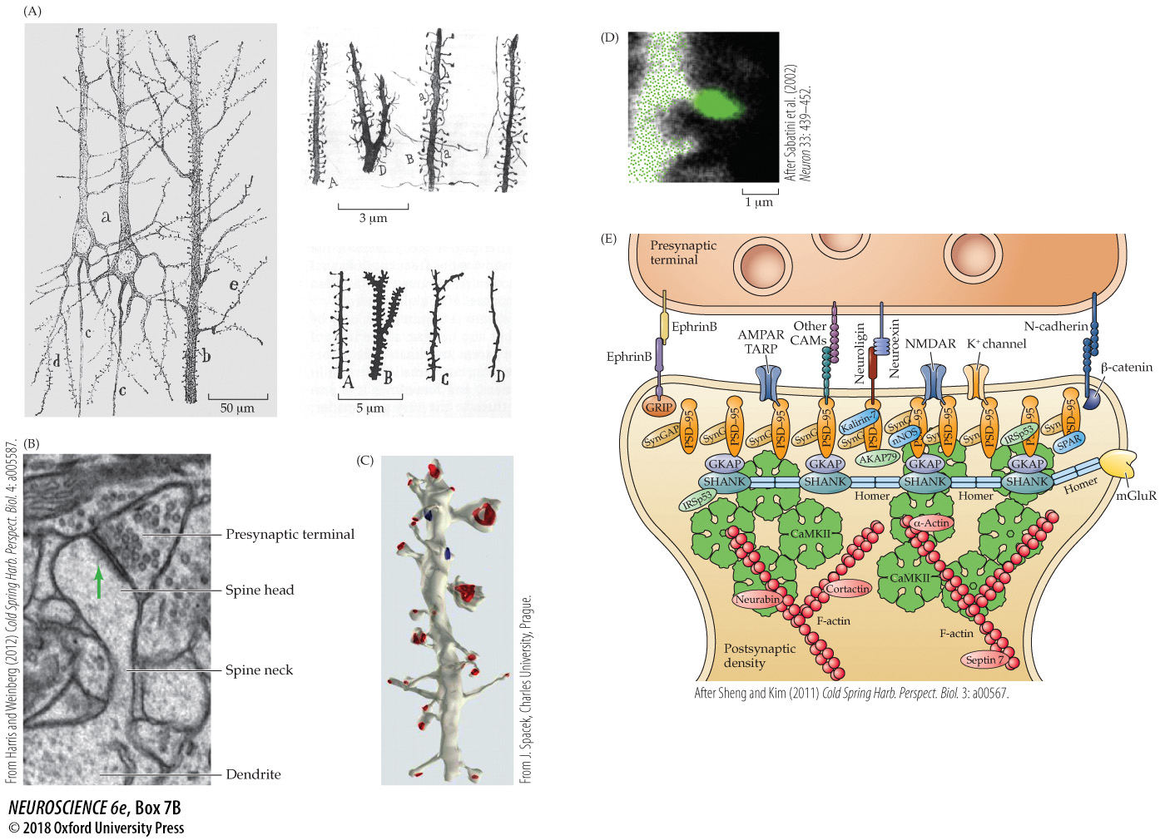
Dendritic Spines
Notes:
Box 7B Dendritic Spines
(A) Cajal’s classic drawings of dendritic spines. Left, dendrites of cortical pyramidal neurons. Right, higher-magnification images of several different types of dendritic spines. (B) Electron micrograph of an excitatory synapse in the hippocampus. Green arrow indicates postsynaptic density. (C) Reconstruction of a small region of the dendrite of a hippocampal pyramidal neuron, revealing a remarkable diversity in spine structure. Red structures indicate postsynaptic densities within each spine. (B from Harris and Weinberg, 2012; C from http://synapseweb.clm.utexas.edu/atlas; reprinted with permission from J. Spacek.) (D) Localized Ca²⁺ signal (green) produced in the spine of a hippocampal pyramidal neuron following activation of a glutamatergic synapse. (E) Postsynaptic densities include dozens of signal transduction molecules, including glutamate receptors (AMPA-type [AMPAR], NMDA-type [NMDAR], mGluR), other ion channels such as K⁺ channels, and many intracellular signal transduction molecules, most notably the protein kinase CaMKII. Cytoskeletal elements, such as actin and its numerous binding partners, also are prominent and help create the structure of dendritic spines. (D after Sabatini et al., 2002; E after Sheng and Kim, 2011.)

Slide 28
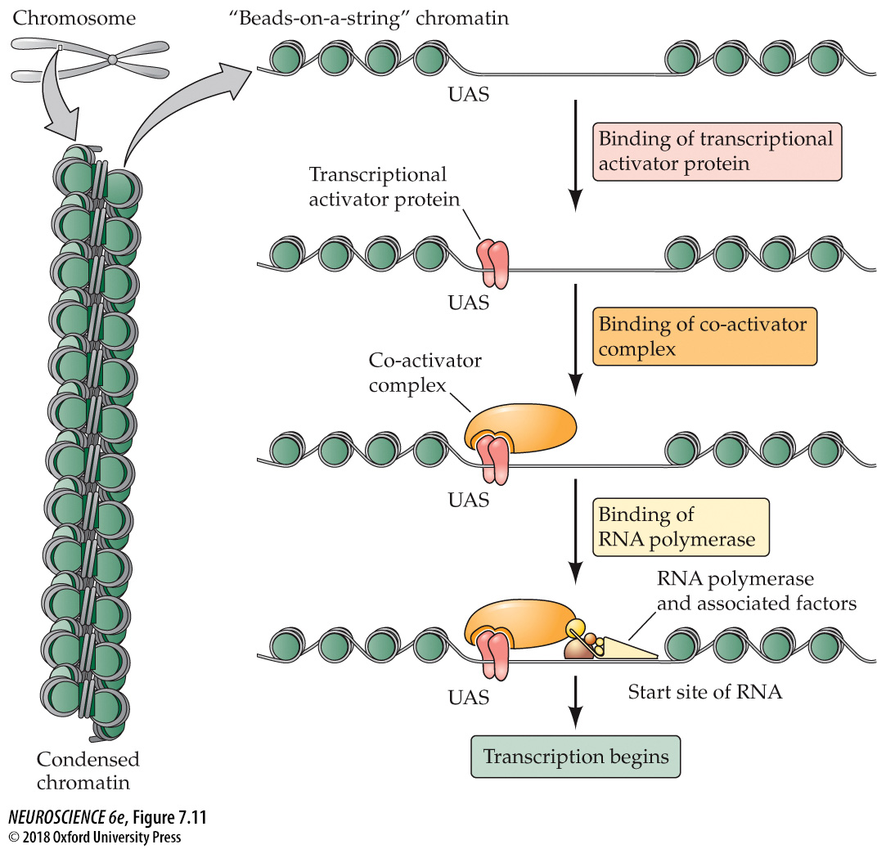
Steps in the transcription of DNA into RNA
Notes:
FIGURE 7.11 Steps in the transcription of DNA into RNA. Condensed chromatin (left) is decondensed into a beads-on-a-DNA-string array (right) in which an upstream activator site (UAS) is free of proteins and is bound by a sequence-specific transcriptional activator protein (a transcription factor). The transcriptional activator protein then binds co-activator complexes that enable the RNA polymerase with its associated factors to bind at the start site of transcription and initiate RNA synthesis.

Slide 29
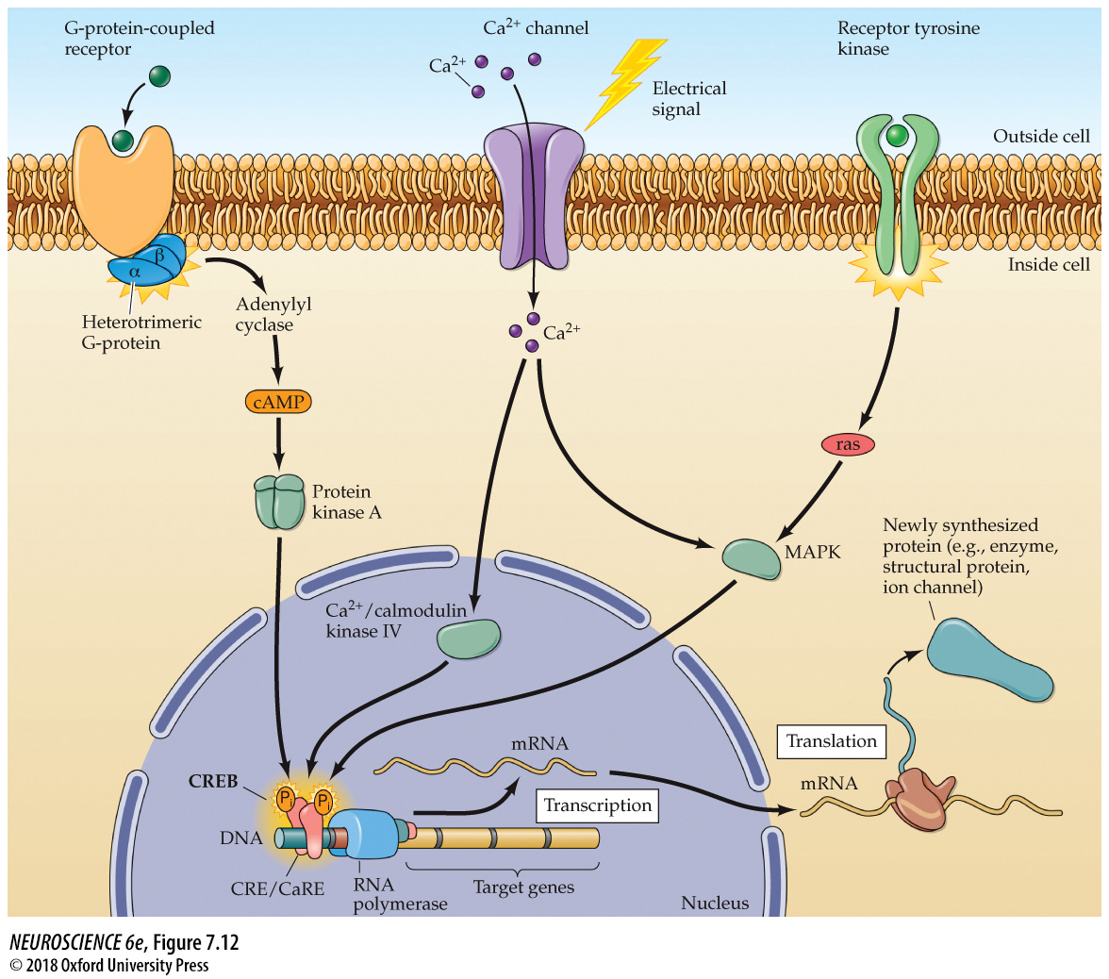
Transcriptional regulation by CREB
Notes:
FIGURE 7.12 Transcriptional regulation by CREB. Multiple signaling pathways converge by activating kinases that phosphorylate CREB. These include PKA, Ca²⁺/calmodulin kinase IV, and MAPK. Phosphorylation of CREB allows it to bind co-activators (not shown in the figure), which then stimulate RNA polymerase to begin synthesis of RNA. RNA is then processed and exported to the cytoplasm, where it serves as mRNA for translation into protein.

Slide 30
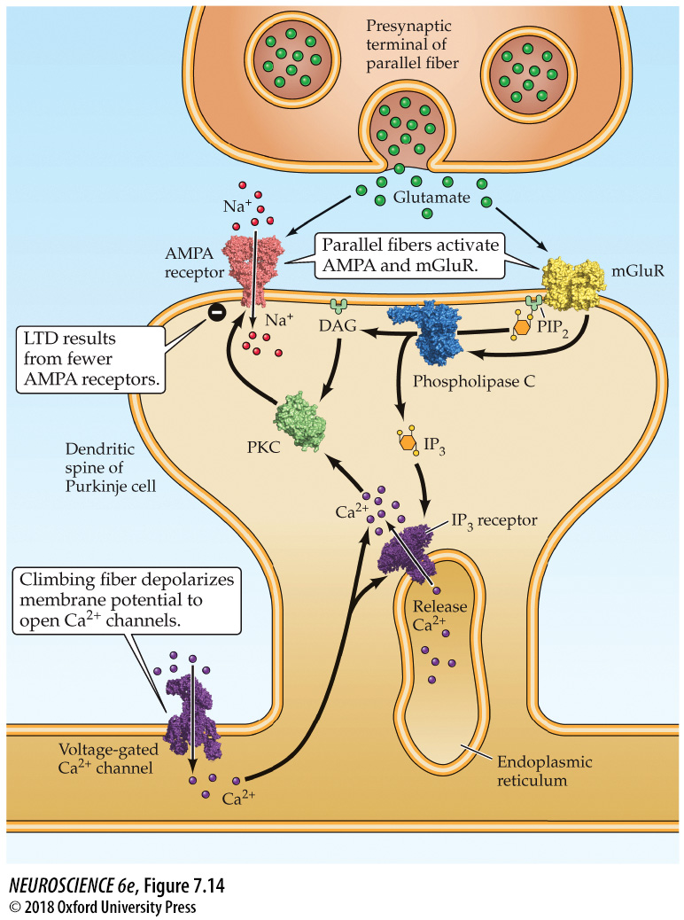
Signaling at cerebellar parallel fiber synapses during long-term synaptic depression
Notes:
FIGURE 7.14 Signaling at cerebellar parallel fiber synapses during long-term synaptic depression. Glutamate released by parallel fibers activates both AMPA-type and metabotropic receptors. The latter produce IP₃ and DAG in the Purkinje cell. When paired with a rise in Ca²⁺ associated with activity of climbing fiber synapses, the IP₃ causes Ca²⁺ to be released from the endoplasmic reticulum, while Ca²⁺ and DAG together activate protein kinase C. These signals together change the properties of AMPA receptors to produce long-term depression.

Slide 31
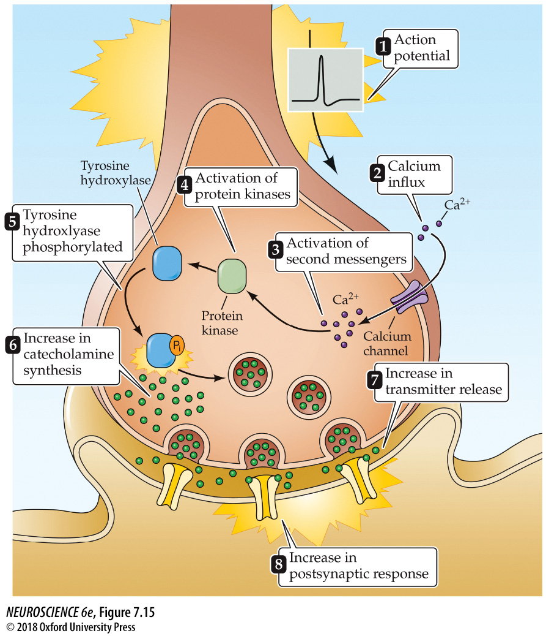
Regulation of tyrosine hydroxylase by protein phosphorylation
Notes:
FIGURE 7.15 Regulation of tyrosine hydroxylase by protein phosphorylation. Tyrosine hydroxylase governs the synthesis of the catecholamine neurotransmitters and is stimulated by several intracellular signals. In the example shown here, neuronal electrical activity (1) causes influx of Ca²⁺ (2). The resultant rise in intracellular Ca²⁺ concentration (3) activates protein kinases (4), which phosphorylates tyrosine hydroxylase (5), stimulating catecholamine synthesis (6). This increased synthesis in turn increases the release of catecholamines (7) and enhances the postsynaptic response produced by the synapse (8).

